Slide 1
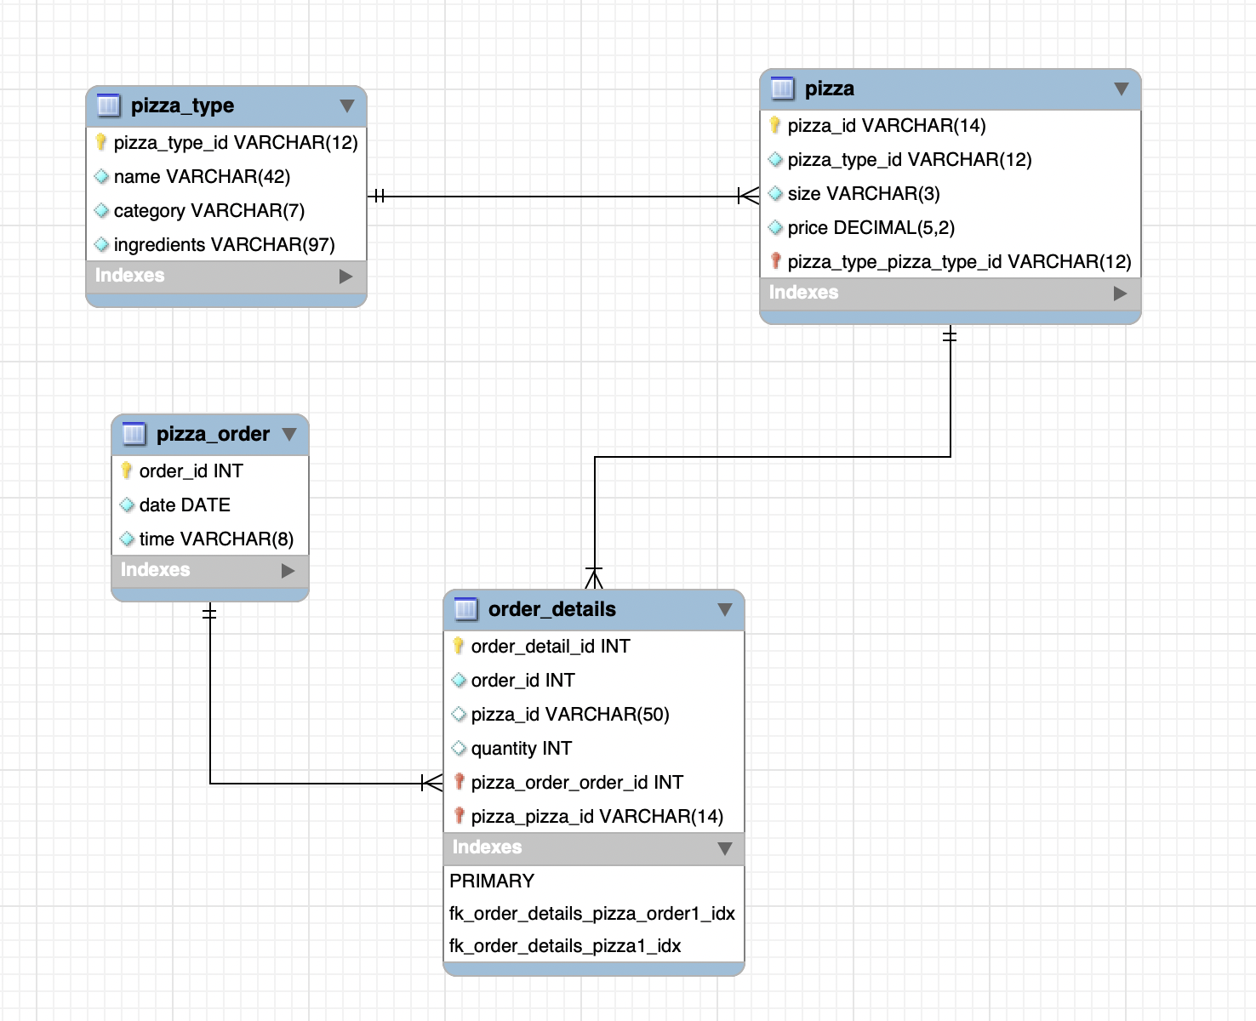
Pizza Sales Database diagram
Fact
Sales
Dimension 1: Product
Dimention 2: Order
Price
Unit
Pizza Name
Pizza Category
Date
Time

Slide 2
Analytic Plan
Annual Total Sales
Monthly Sales
Sales in time, day and month
Analysis the sales by pizza type.
Find out the best seller pizza type and size
To create Sales operation which can insert data.

